Slide 1
“Mindfulness, Mindsight, and a Healthy Mind” Daniel J. Siegel Mindsight Institute

Slide 2
MINDFULNESS: Mindful Awareness
“A form of awareness that comes from paying attention, on purpose, non-judgmentally to the present moment”
Mindful Practice involves:
Focusing Attention on Intention
Awareness of Awareness itself
“Training the Mind” to focus on inner experience
Differentiating Sensory Awareness from Observing/Narrating Awareness and Linking with Attentional Practice

Slide 3
Mindfulness: Using the focus of attention to transform…
The Brain (Davidson et al) (Lazar et al)
The Immune System (Davidson et al)
Sense of Well-Being (Kabat-Zinn et al)
Physician Burn-Out (Reduction: Epstein, et al)
Attention (Jha, et al)
Relational Function (Shapiro, et al)
Epigenetic Regulation (Fredrickson, et al)
Telomerase Levels (Epel, et al)

Slide 4
Mindsight: Insight Empathy and Integration

Slide 5
WHAT CONNECTS RELATIONSHIPS, MIND, AND BODY/BRAIN?
(EMBODIED) BRAIN
MIND
RELATIONSHIPS

Slide 6
RELATIONSHIPS: SHARING
“BRAIN”: THE EMBODIED MECHANISM
MIND: An EMERGENT, SELF-ORGANIZING PROCESS emerging FROM and also REGULATING
the FLOW OF ENERGY AND INFORMATION
within the Body and within our Relationships

Slide 7
A Working Definition of a core aspect of the Mind
An Embodied and Relational
Self-Organizing Emergent Process that
Regulates the
Flow of Energy and Information
(An Emergent Property arises from the interactions of elements of a system—i.e. from the flow of energy within embodied neural activity and relational communication)

Slide 8
Mindfulness, Mindsight and Health: Presence
What does it mean to be “present”?
Why is presence one of the most important aspects of our interpersonal relationships?
How does presence increase telomerase, improve epigenetic regulation, and enhance immune function?
What is the connection among presence, attunement, resonance and trust (PART)?

Slide 9
Integration: A simple but powerful framework
Integration is:
The
LINKAGE
of
D I F F E R E N T I A T E D
Parts

Slide 10
The River of Integration

Slide 11
Middle Prefrontal Functions
Bodily Regulation
Attuned Communication
Emotional Balance
Fear Extinction
Flexibility
Insight
Empathy
Morality
Intuition

Slide 12
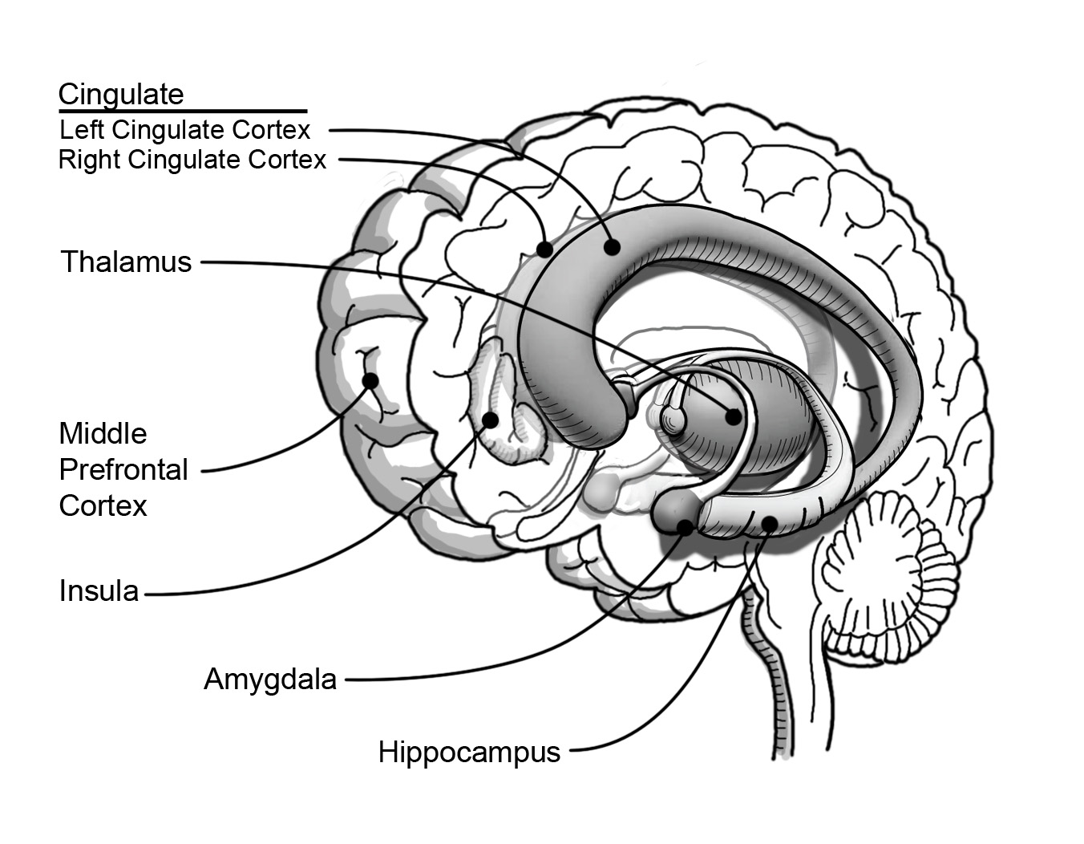

Slide 13
STRENGTHENING THE MIND: Enhancing Regulation: Monitoring Modulating

Slide 14
Major Mindsight Principles
Mind viewed as a self-organizing emergent property or process that REGULATES energy and information flow
The mind is both EMBODIED and RELATIONAL
Regulation entails MONITORING and MODIFYING
Harmony emerges from integration—the linkage of differentiated elements of a system
Chaos and/or Rigidity result from impaired integration

Slide 15
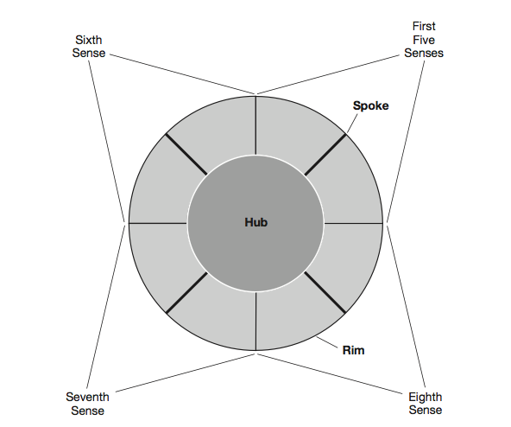
The Wheel of Awareness
Mind Your Brain, Inc., (c) 2015

Slide 16
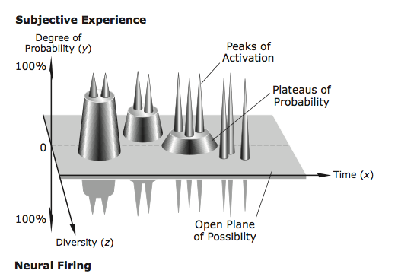
The Plane of Possibility

Slide 17
“SELF”: Singular Noun or Plural Verb?

Slide 18
“MWe”

Slide 19
Integration
Made Visible
Is
Kindness and Compassion

